Slide 1

AI Travel Itinerary Generator
Generative AI + Personalization
CAP 4630 – Intro to Artificial Intelligence
Team: Curtis Williams , Kylie Capes and Mackenzie VanMeter
Notes:
Open with the motivation: simplifying trip planning through personalized AI itineraries.

Slide 2
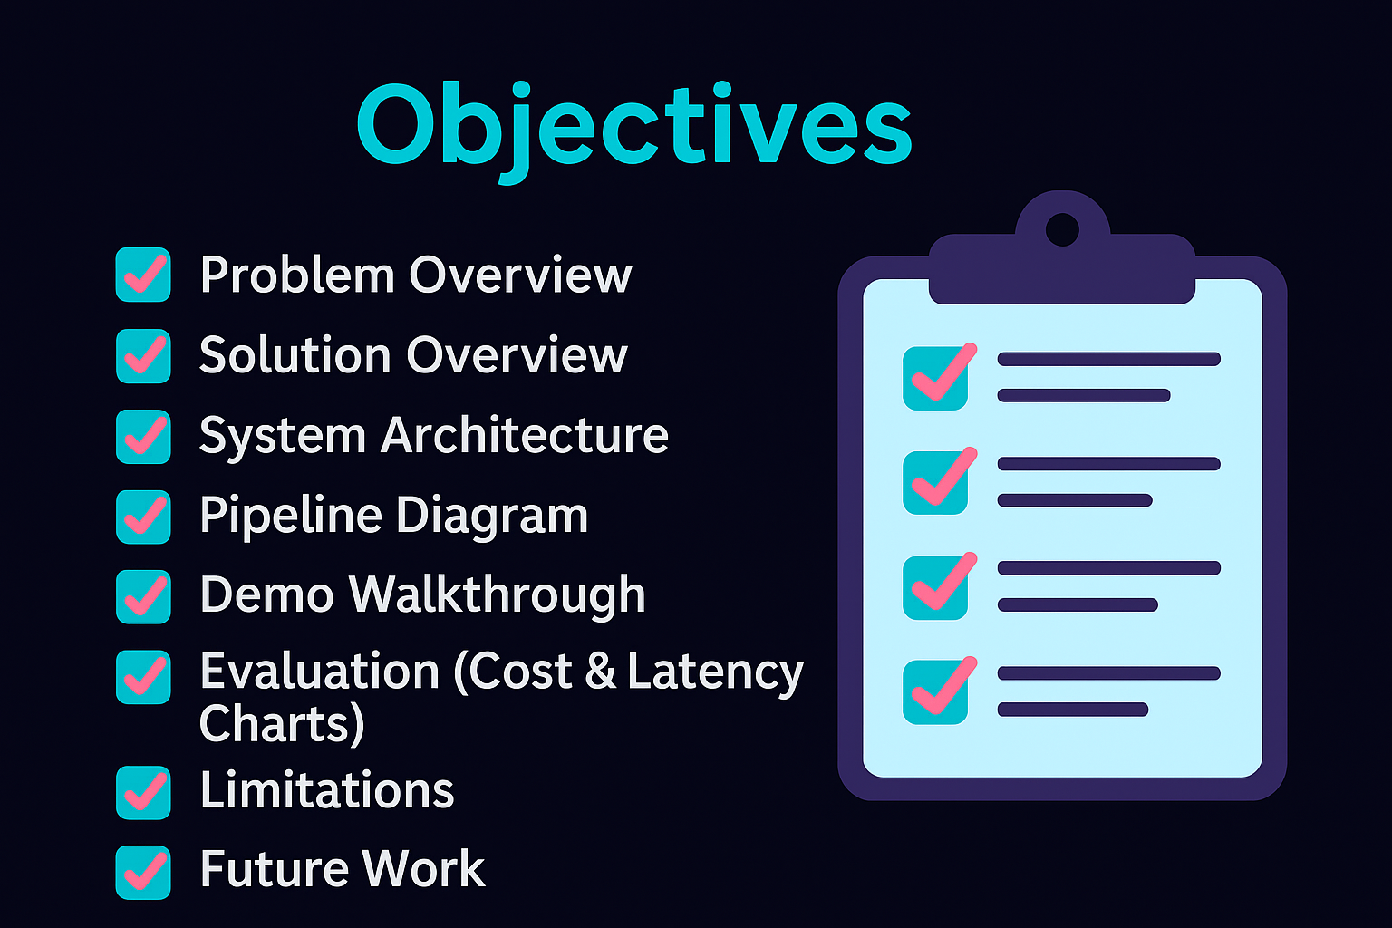
Notes:
Briefly describe the problem: travelers want AI help that is truly personalized.

Slide 3
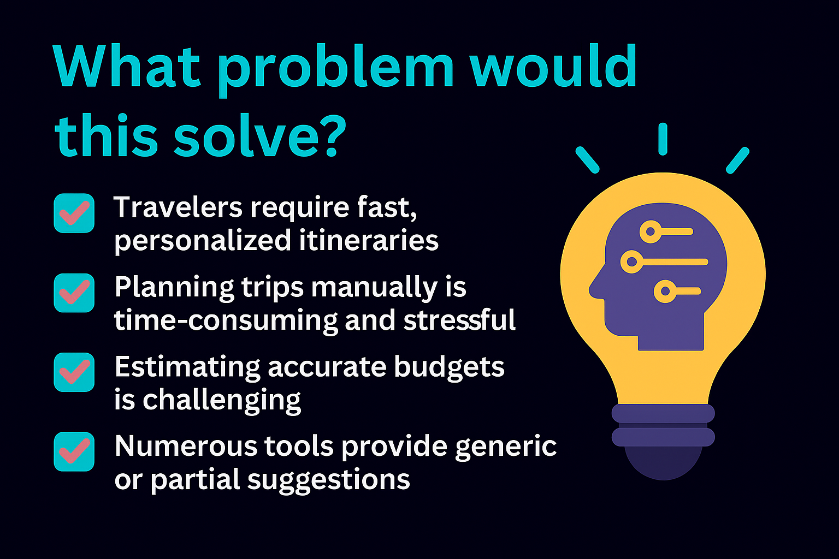
Notes:
Explain the full-stack design. Flask handles UI, LangChain handles LLM prompts.

Slide 4
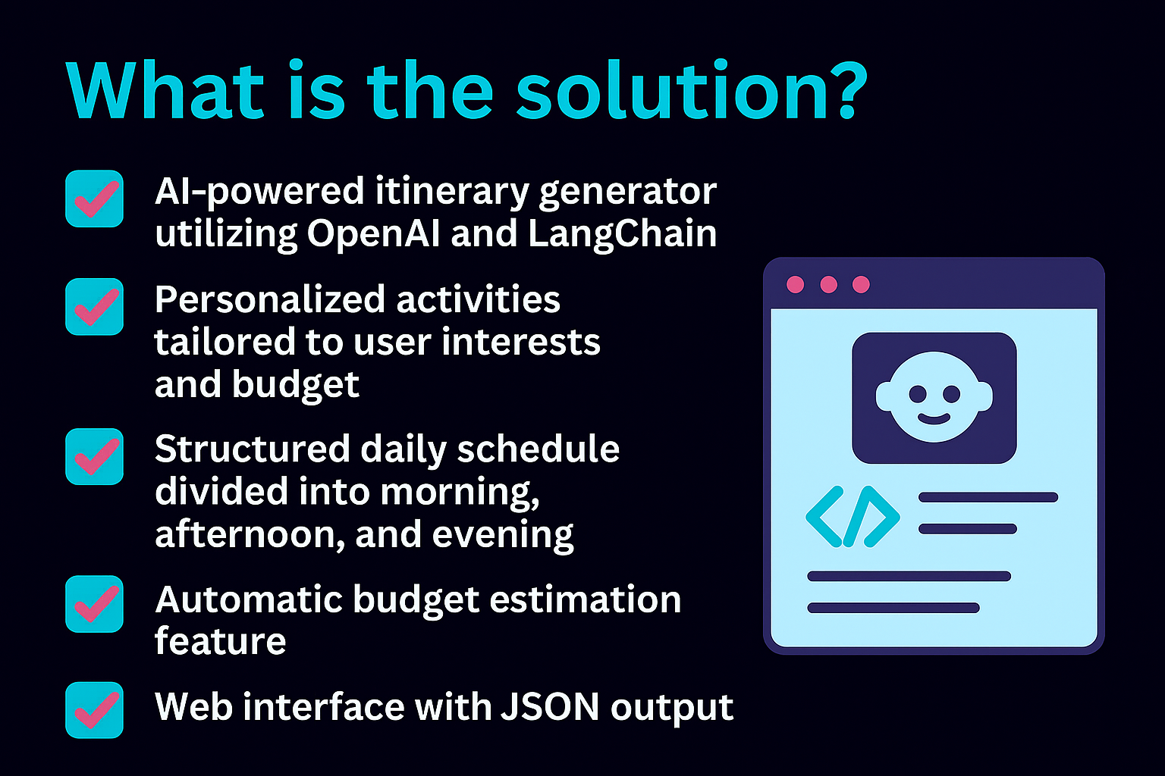
Notes:
Show the pipeline logic step-by-step. Emphasize prompt structure importance.

Slide 5
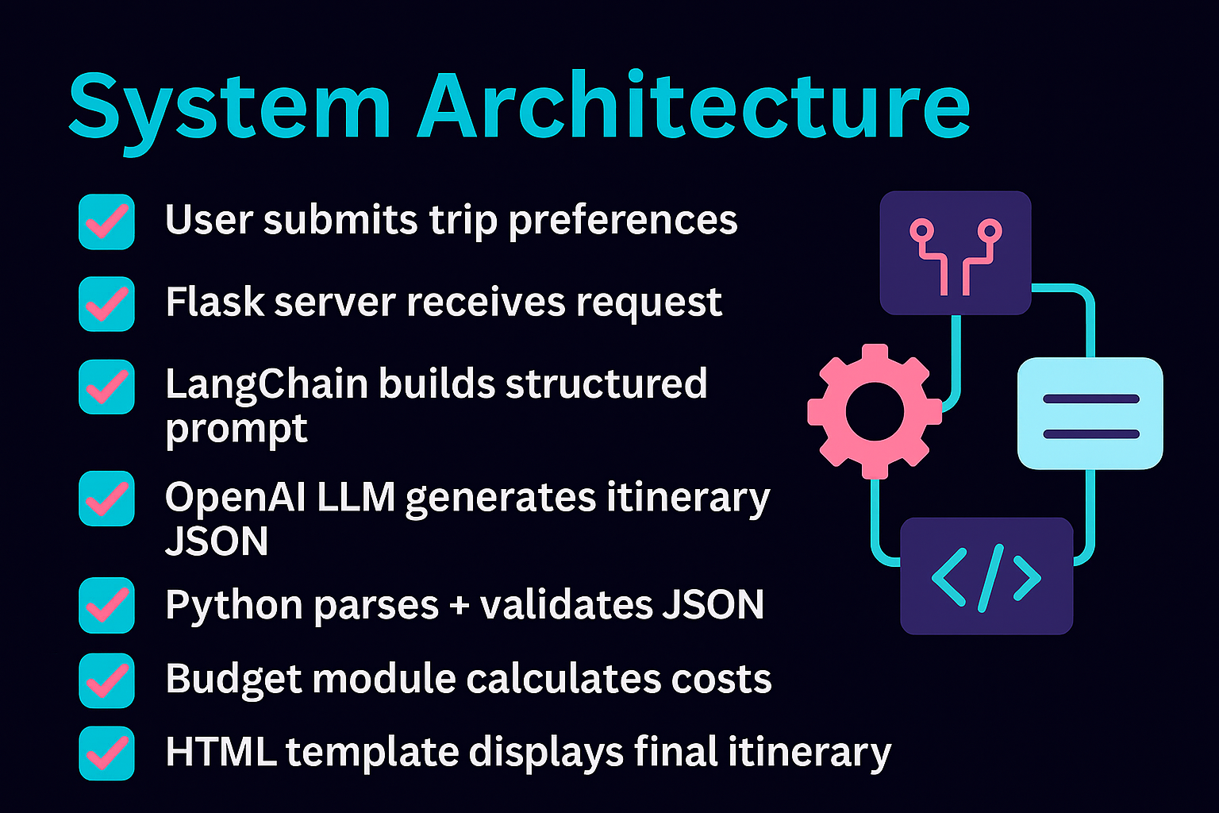
Notes:
Discuss your prompt design philosophy and improvements from trial runs.

Slide 6
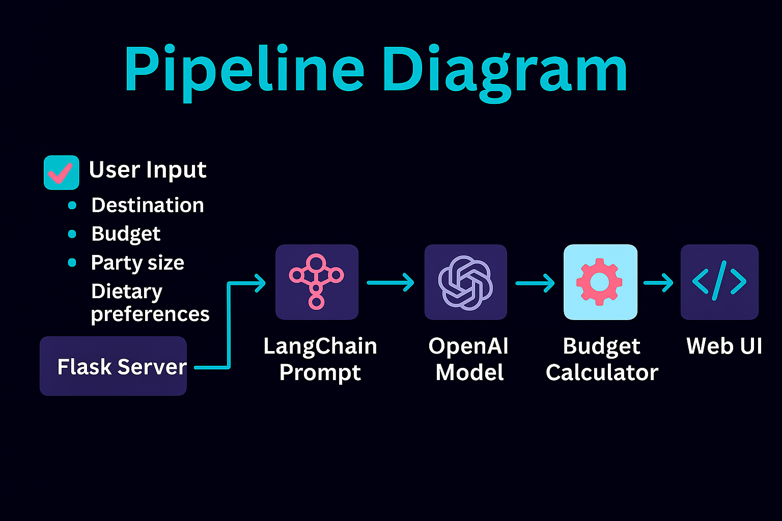
Notes:
Describe your live demo or screenshots of app results.

Slide 7
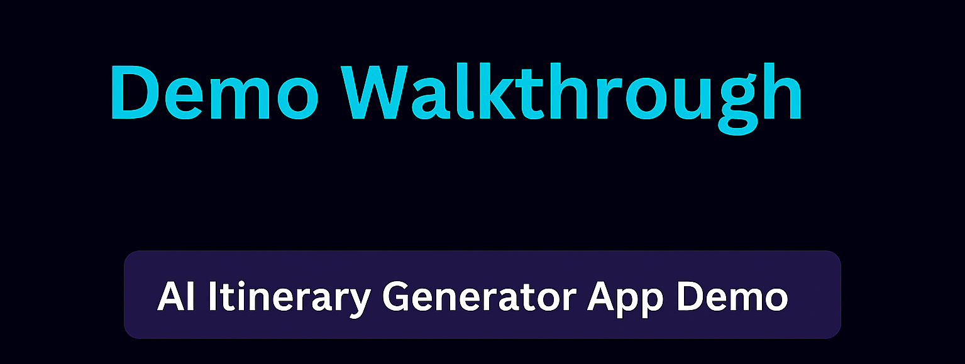
https://8876cc40-604c-49f4-a2f6-9ec1e60d9b32-00-w8z19ng1r46u.picard.replit.dev/
Notes:
Explain that gpt‑4o‑mini is faster at low token counts, while gpt‑4.1 scales slower but richer responses.

Slide 8
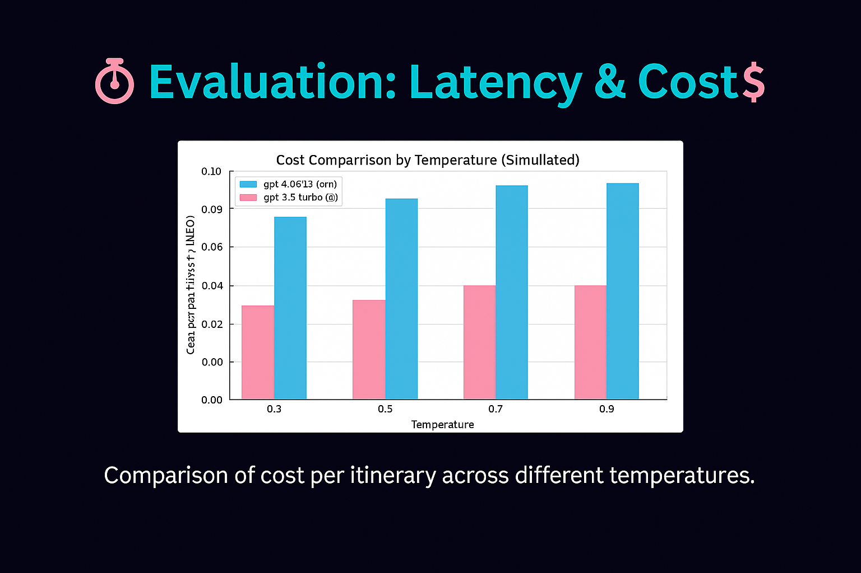
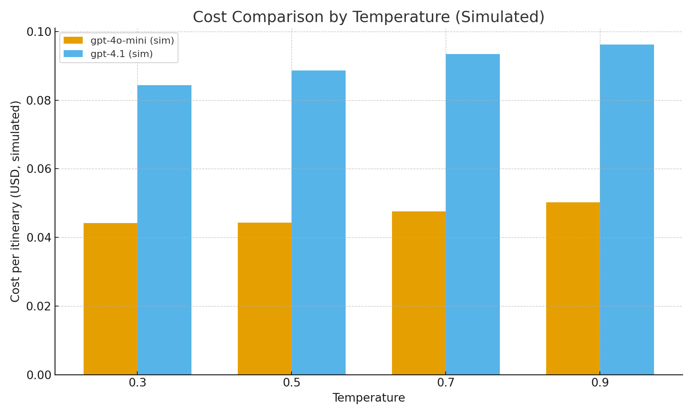
Notes:
Compare simulated costs; explain optimal temperature for balance between creativity and cost.

Slide 9
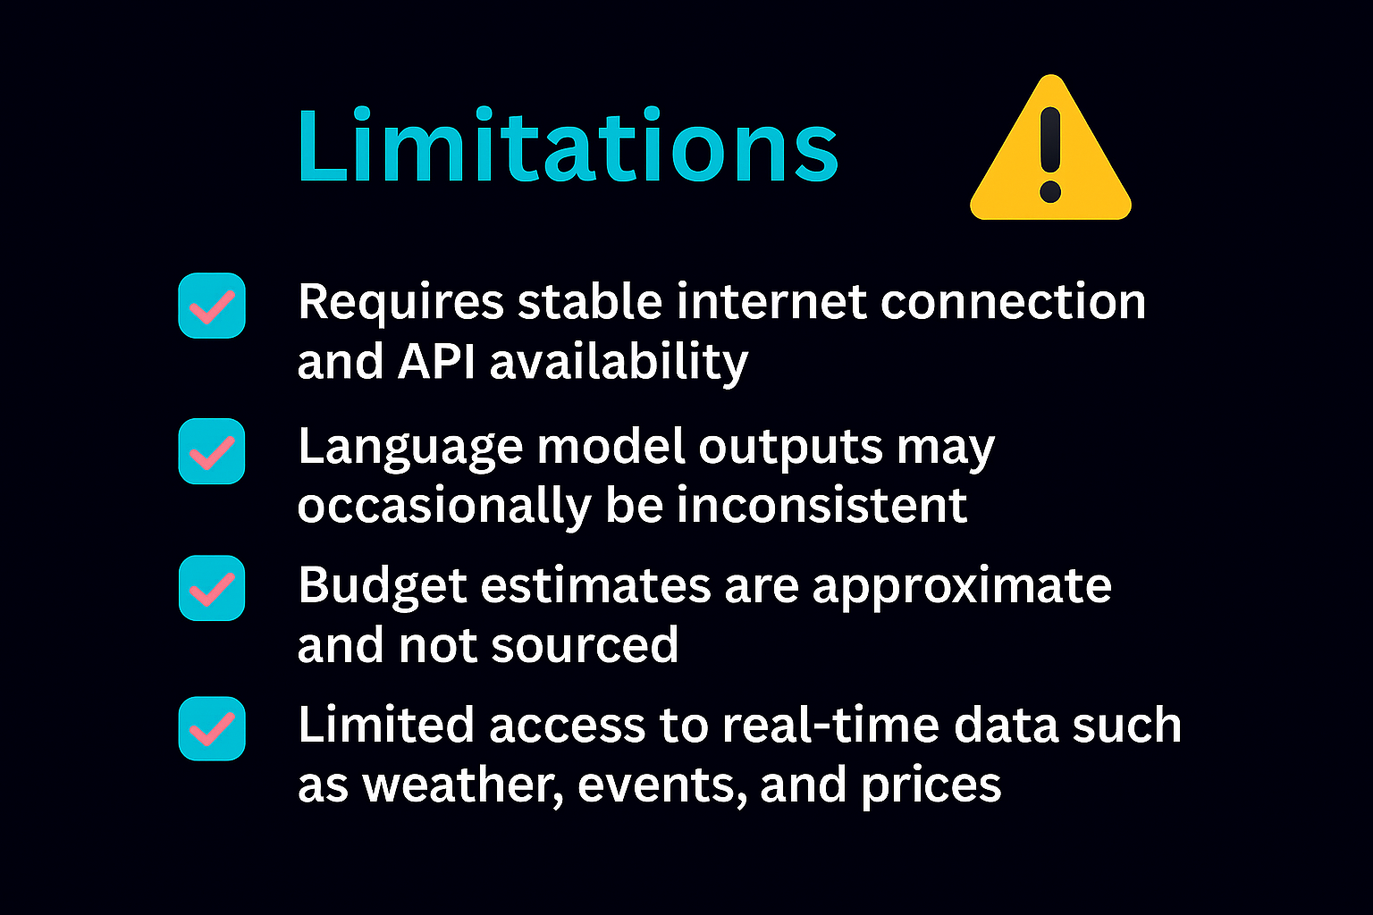
Notes:
Be transparent about constraints; propose retrieval‑augmented enhancement.

Slide 10
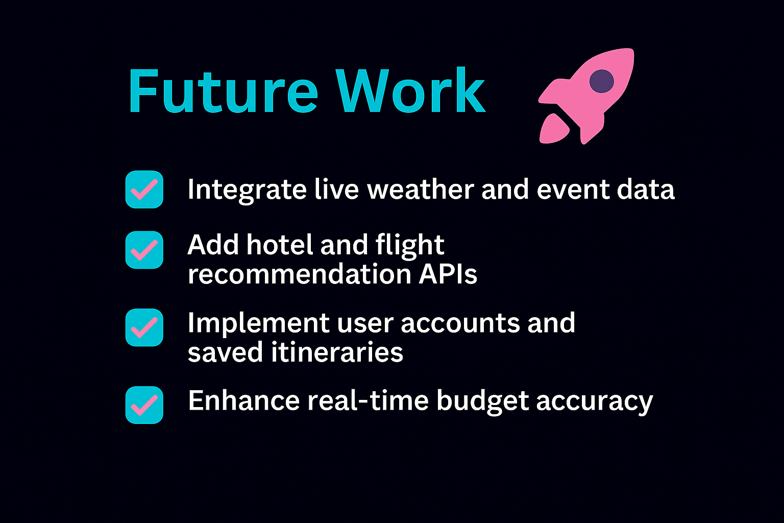
Notes:
Future roadmap—align with applied AI best practices.

Slide 11
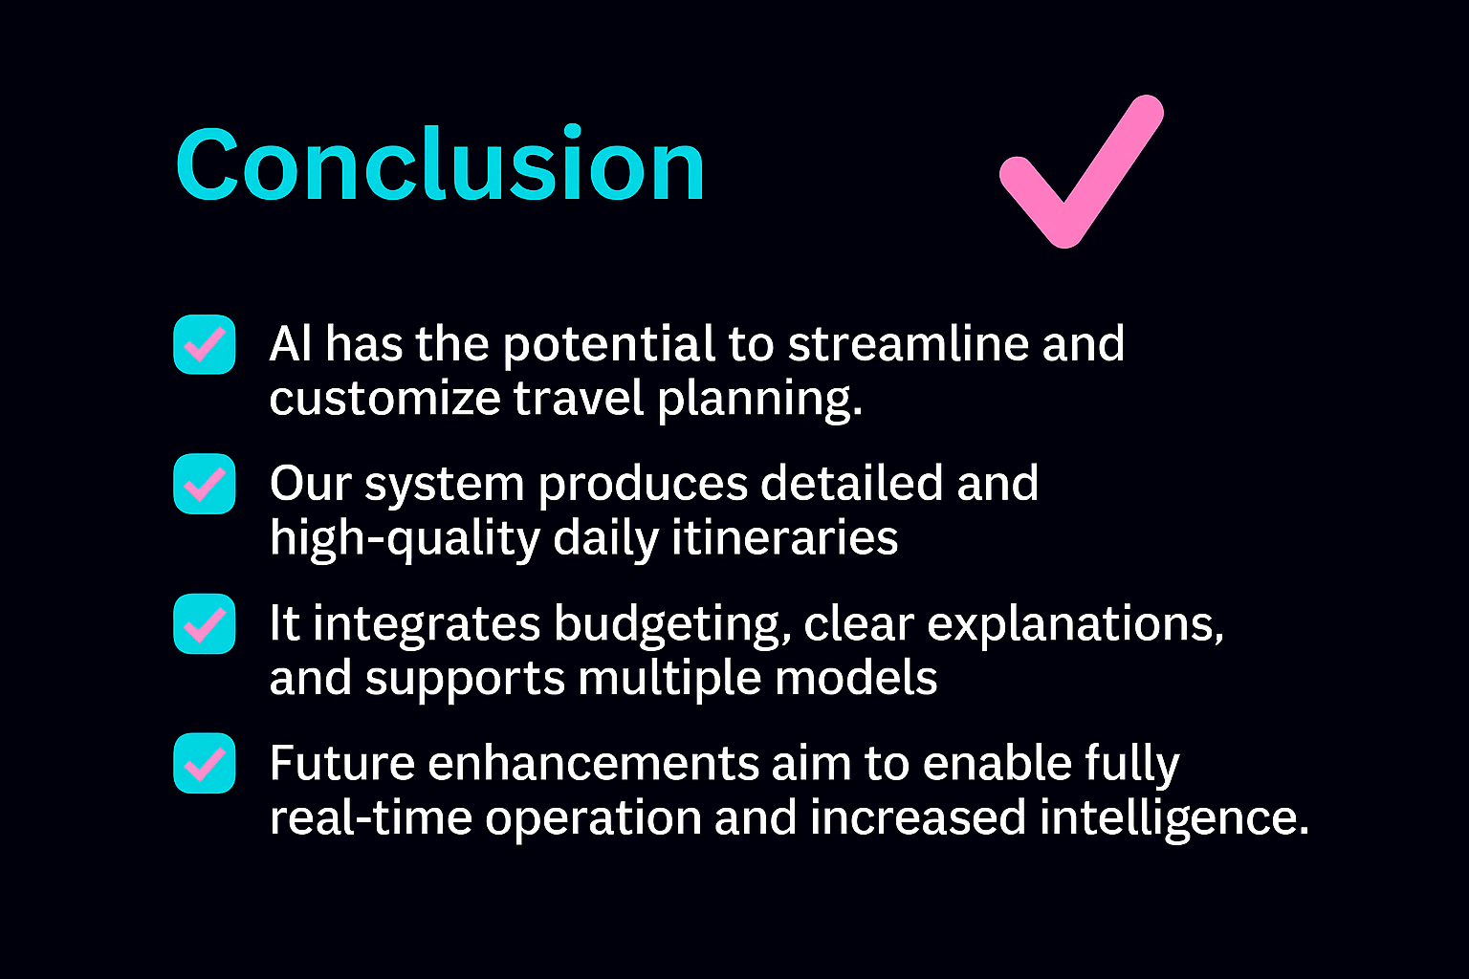
Notes:
End confidently—highlight innovation, scalability, and relevance to AI in daily life.

